Slide 1

Hybrid Decentralization for Multi-Robot Orienteering with Mothership-Passenger Systems
Nathan L. Butler and Geoffrey A. Hollinger
Robotics Program, School of Mechanical, Industrial, and Manufacturing Engineering
Oregon State University
NSF Award No.
2322055

Slide 2
In this work, we leverage a hybrid centralized-distributed network available in robotic Mothership-Passenger systems to solve complex orienteering problems.

Slide 3
We motivate our work with an underwater multi-robot system designed to explore polar ice shelves.
Mothership

Slide 4
We consider this reduced network topology
Mothership

Slide 5
Centralized Topology
Mothership
The Mothership may be thought of as a centralized controller, capable of sending commands to each Passenger

Slide 6
Distributed Topology
Mothership
The Passengers may be considered as a distributed network, capable of sharing information between themselves and the Mothership

Slide 7
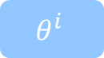
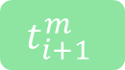

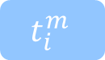
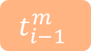

Hybrid Rescheduling
Mothership
We introduce the hybrid tour scheduling algorithm for Passenger orienteering.
$$t_{i−1}^{m}$$
$$t_{i}^{m}$$
$$t_{i+1}^{m}$$
Passenger i
$$t_{i}^{m}$$
SOP Solver
(MCTS)
$$T_{i}$$
Mothership
Task Data
Task Data
Neighboring Passengers
STOP & SOP Solver
(Sim-BRVNS)
UpdateScheduleDists
$$θ^{i}$$

Slide 8
With this hybrid framework, Passengers with strong connections to the Mothership are equipped to operate using well-informed centrally-developed tours while Passengers with strong connections to neighboring Passengers solve tours as a distributed system.
$$t_{i−1}^{m}$$
$$t_{i}^{m}$$
$$t_{i+1}^{m}$$
Passenger i
$$t_{i}^{m}$$
SOP Solver
(MCTS)
$$T_{i}$$
Mothership
Task Data
Task Data
Neighboring Passengers
STOP & SOP Solver
(Sim-BRVNS)
UpdateScheduleDists
$$θ^{i}$$

Slide 9
This enables the system to take advantage of the high-performing solutions generated by a centralized controller while remaining robust to lost connections with the central node.
$$t_{i−1}^{m}$$
$$t_{i}^{m}$$
$$t_{i+1}^{m}$$
Passenger i
$$t_{i}^{m}$$
SOP Solver
(MCTS)
$$T_{i}$$
Mothership
Task Data
Task Data
Neighboring Passengers
STOP & SOP Solver
(Sim-BRVNS)
UpdateScheduleDists
$$θ^{i}$$

Slide 10
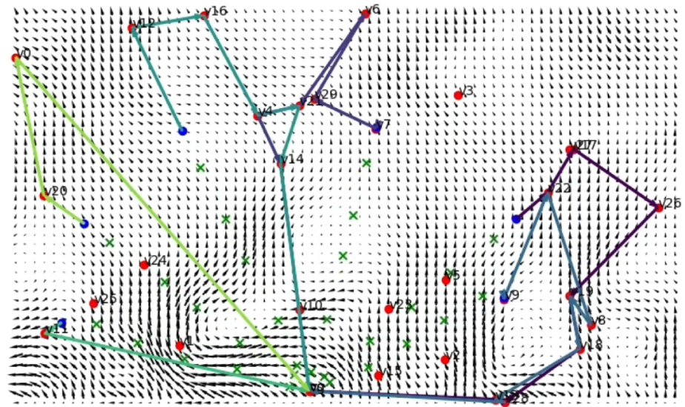
Simulation Environment
Worker Robots (Blue o)
Support Robots (Green x)
Tasks (Red o)
Planned Tours
Simulated ocean currents cause unpredictable battery loss

Slide 11
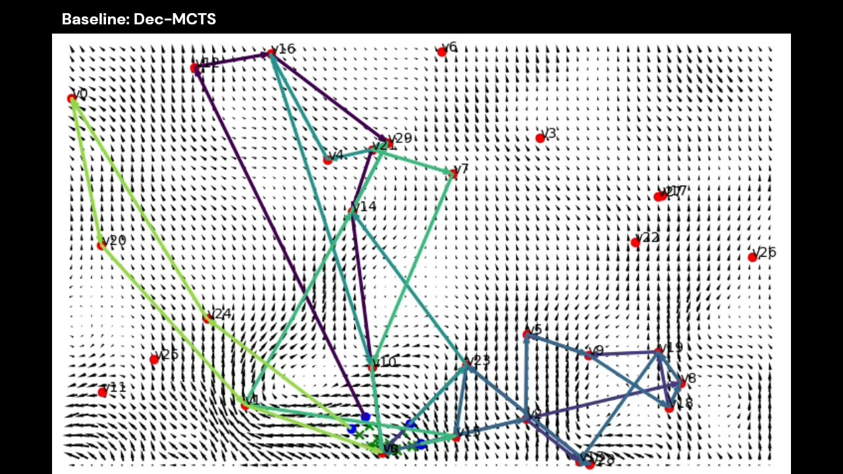
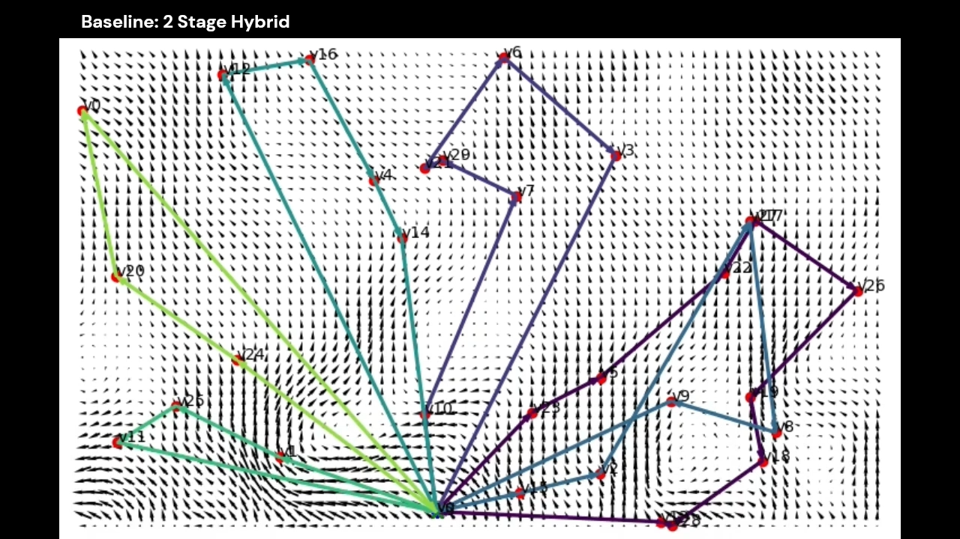
Simulation 1: Baseline Scenario Performance
Dec-MCTS OR Sim-BRVNS
Hybrid
Decentralized Monte Carlo Tree Search
Distributed planning without Mothership
Our Hybrid Rescheduling Algorithm
Initial plan from Mothership
Revised online using hybrid method

Slide 12
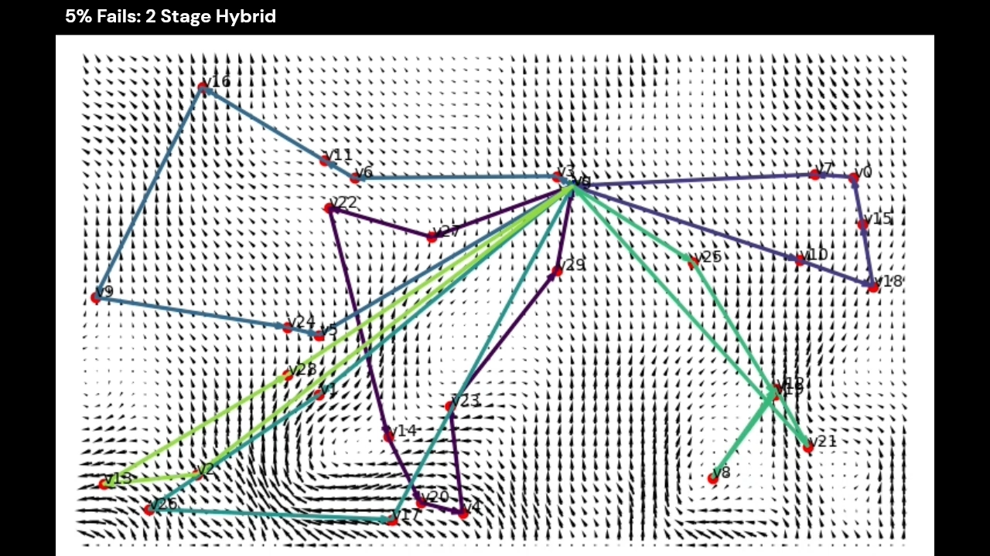
Simulation 2: Replanning with Robot Failures
Tasks originally scheduled for failed robots are integrated into other robots’ plans.

Slide 13
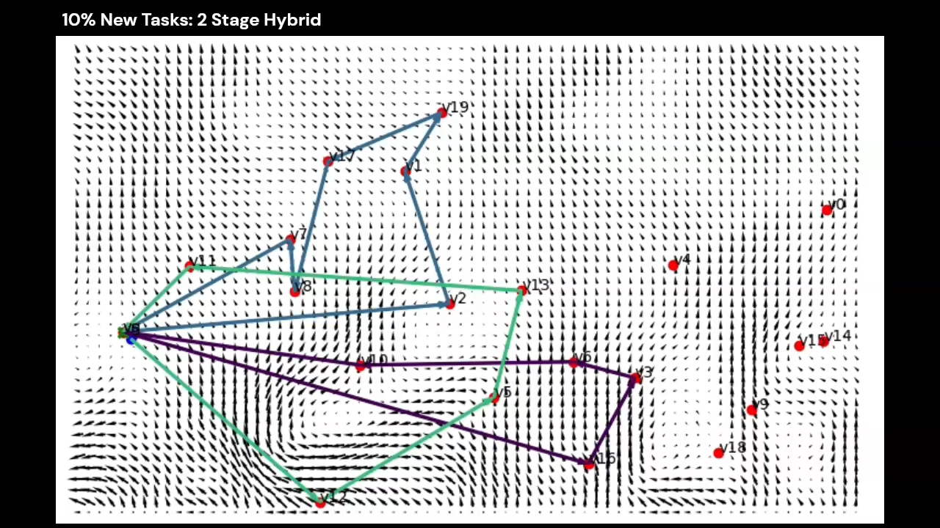
Simulation 3: Replanning with New Tasks
New tasks are incorporated into robots’ plans online.

Slide 14
Contact:
Nathan Butler: butlnath@oregonstate.edu
Geoffrey Hollinger: geoff.hollinger@oregonstate.edu

